Slide 1

Chapter 1
Introduction in Performance Modeling
Performance Evaluation of the Internet of Things (IoT)
Module Course: Performance Evaluation of Distributed Systems
Prof. Tobias Hoßfeld, Summer Semester 2022

Slide 2

Disclaimer and Copyright Notice
Lecture slides, figures, and scripts are based on the open access text book “Performance Modeling and Analysis of Communication Networks”. The book and scripts are licensed under the Creative Commons License Attribution-ShareAlike 4.0 International (CC BY-SA 4.0). If you remix, transform, or build upon the material, you must distribute your contributions under the same license as the original.
The book must be cited and the disclaimer attached when using lectures slides or scripts.
Tran-Gia, P. & Hossfeld, T. (2021). Performance Modeling and Analysis of Communication Networks - A Lecture Note. Würzburg University Press. https://doi.org/10.25972/WUP-978-3-95826-153-2
Website to download book, exercises, slides and scripts: https://modeling.systems/

Slide 3
Chapter 1
1 Introduction in Performance Modeling
1.1 Modeling Concept and Levels of Abstraction
1.2 Notation for Single-Stage Queueing Models
1.2.1 Kendall’s Notation
1.2.2 Extended Kendall’s Notation: A/B/n/S/m/D
1.3 Modeling Examples
1.3.1 Handshaking Protocol
1.3.2 Network Dimensioning in Mobile Networks
1.3.3 Software Defined Networking and Switch Table Occupancy
1.3.4 Video Streaming Applications and QoE
1.3.5 Resource Sharing in Cloud Computing
1.3.6 Internet of Things and Smart City Applications
1.3.7 Overload Control in Communication Systems

Slide 4
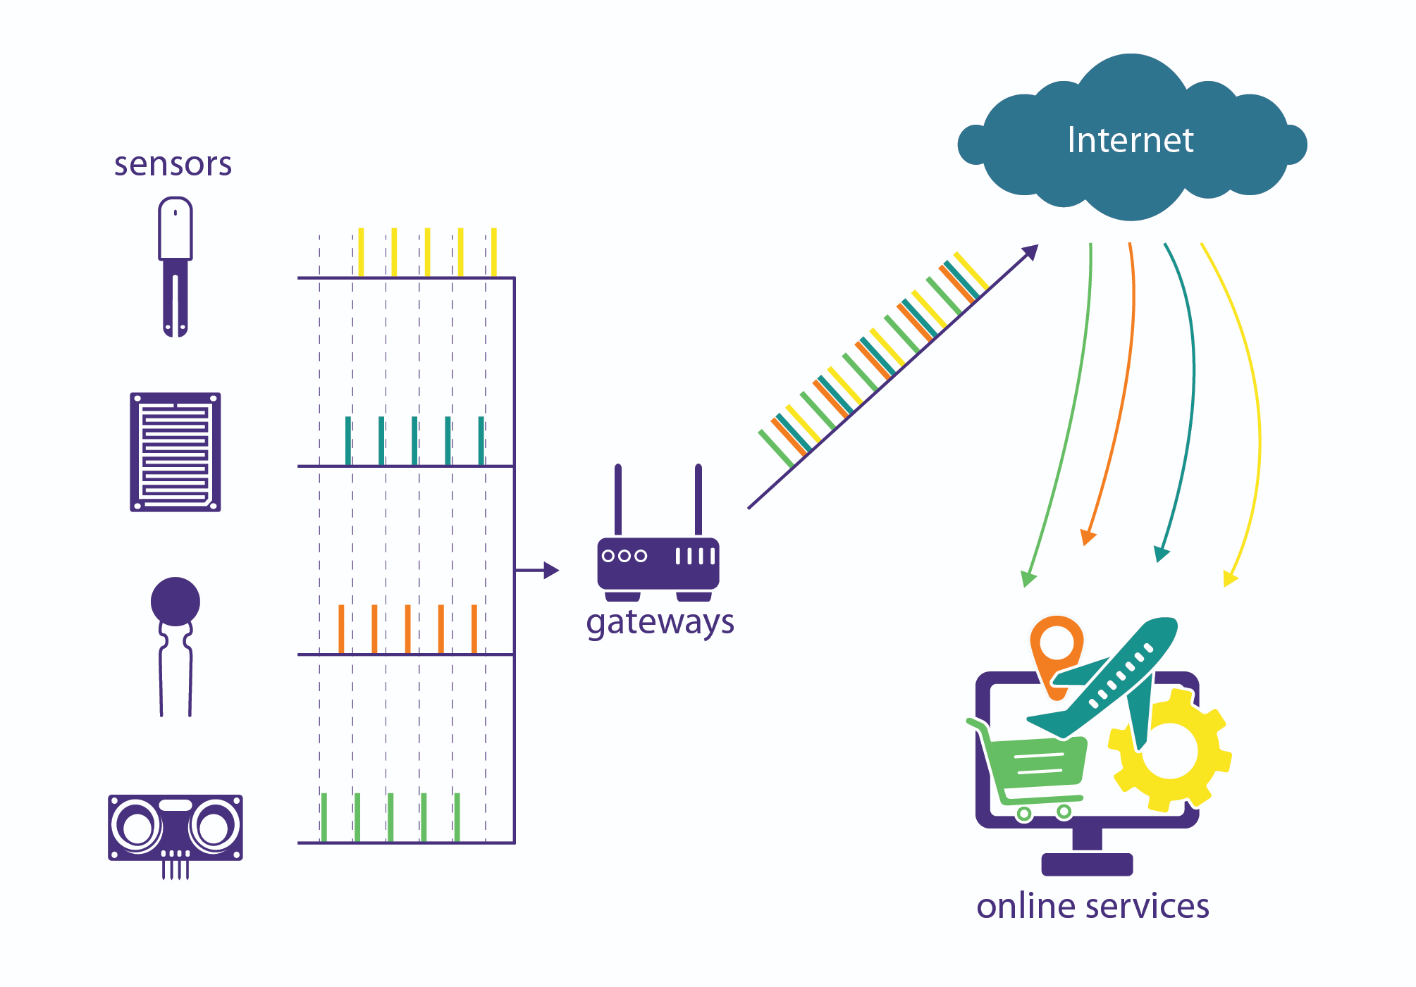
Example: Internet of Things (IoT)
Some relevant questions
How can an IoT system with millions of sensors be modeled? What is the scalability of such a system?
How many gateways are needed in a smart city to ensure good quality of service?
How can server capacity be dimensioned in a cloud? How many servers or VMs are required?
How well does channel access mechanism work for technologies such as nB-IoT or LoRaWAN? What is the probability of a successful data transfer? What is the energy efficiency of the channel access?
Models from queuing theory applied to IoT systems

Slide 5


IoT System
Things networked using Internet technologies
may be resource constrained (energy consumption, RAM, ROM)
may have to sent a couple of bytes only
Internet
Smart Things
IoT Gateways
Online Services

Slide 6
IoT Gateway
Bridges the communication gap between IoT devices and the cloud, e.g. translating protocols, adding security features, etc.
May offer local processing, filtering, caching, storage solutions
May control smart things
Advantages: lowering costs, mitigate risks, operation and management
Internet
Smart Things
IoT Gateways
Online Services

Slide 7


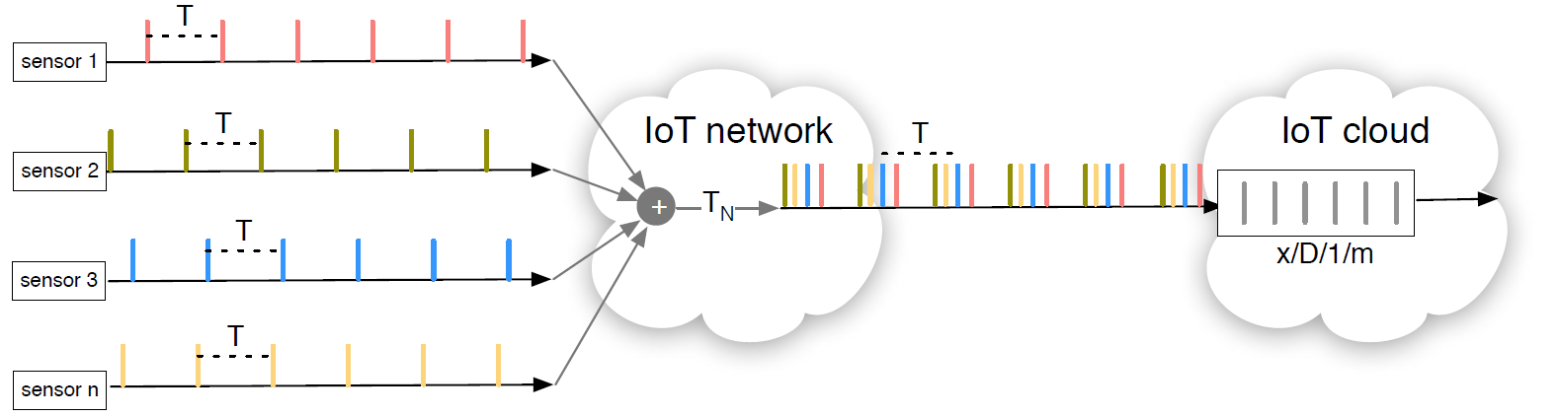


Example: IoT Cloud
How to dimension an IoT cloud load balancer? How much traffic from IoT sensors can be handled such that average waiting time is below a treshold? What is the required processing power?
Waiting
space
Service
unit
Arrival process
Arrival times
Waiting
time
Processing
time
Departure
times

Slide 8
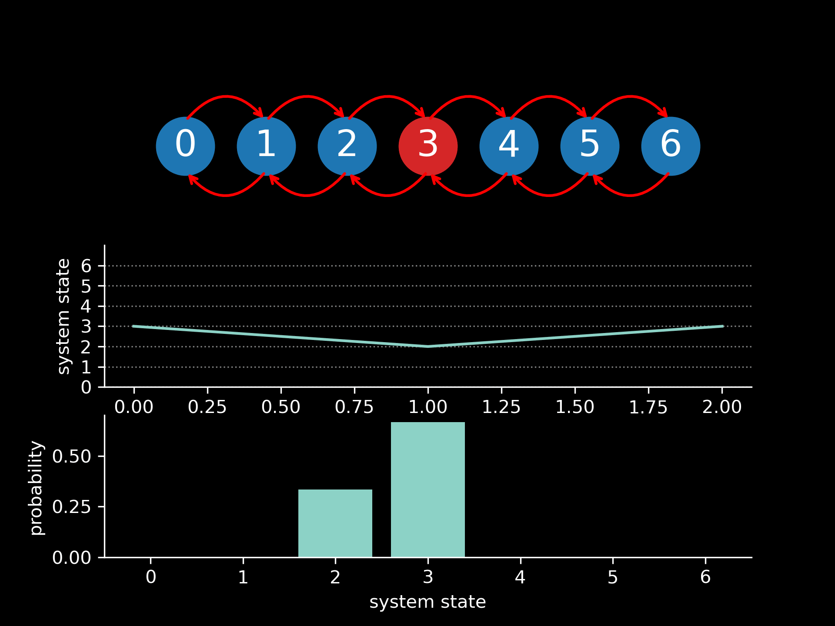

Slide 9
Example: LoRaWAN
Customer Application
Customer Application/ Server Logic
encrypted
LoRaWAN Slave
LoRaWAN Master
encrypted
Packet Forwarding
LoRa MAC
LoRa MAC
Backhaul IP Stack
Backhaul IP Stack
LoRa
MAC
MAC
LoRa PHY: Modulation
LoRa PHY
PHY
PHY
sensor
gateway
Ethernet, 3G, WiFi
network server
What is the performance and energy efficiency of LoRaWAN‘s channel access?

Slide 10
Example: LoRaWAN (f.)
What are the system components?
Waiting
space
Service
unit
Arrival process
Arrival times
Waiting
time
Processing
time
Departure
times

Slide 11








Example: Video Streaming
What is the Quality of Experience of HTTP-based video streaming?
Access Network
Cloud / DC
IP
Core Network
Access Network
Cloud / DC
IP
IP
IP

Slide 12
Modeling Concepts
Level of abstraction

Slide 13
Abstraction Layering of Performance Analysis Techniques

Slide 14
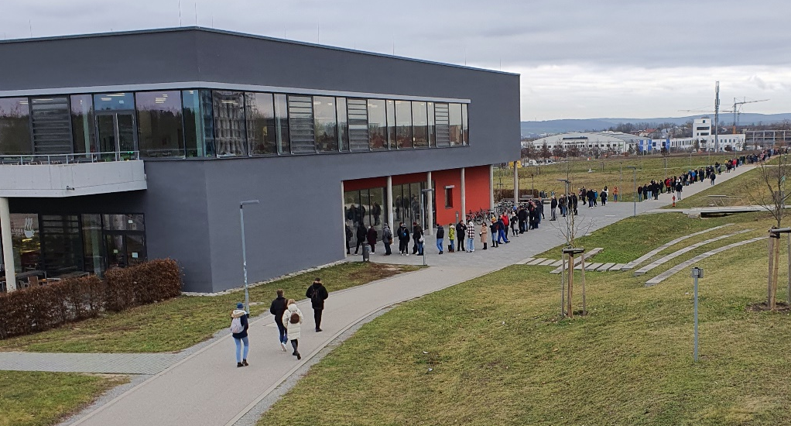
Modeling
Real-world problems & questions
real system
(formal) model
abstraction
specification
(formal) model
improvement
Performance
evaluation
goal: real-world solution & answer
interpretation
transformation
solution within the formal model

Slide 15
Kendall‘s Notation
Single-stage queueing systems

Slide 16
Single-Stage Queueing Models
Single-stage: Jobs or customers arrive at the queue, get processed, and leave the system.
Queueing model requires the definition of the following components:
Traffic sources and associated random arrival processes describing the time between arrivals of jobs in the system.
Service units (or servers) and associated random variables for the duration of service processes.
Queues and associated waiting room capacity and operating disciplines.
Traffic sources
Waiting
space
Service
unit
Arrival process
Arrival times
Waiting
time
Processing
time
Departure
times

Slide 17
Kendall‘s Notation
Single-stage queueing models can be described using Kendall’s notation

Slide 18
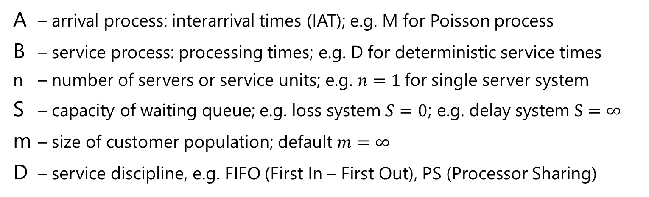
Extended Kendall‘s Notation
A/B/n/S/m/D
A – arrival process: interarrival times (IAT); e.g. M for Poisson process
B – service process: processing times; e.g. D for deterministic service times
n – number of servers or service units; e.g. $n=1$for single server system
S – capacity of waiting queue; e.g. loss system $S=0$; e.g. delay system $S=∞$
m – size of customer population; default $m=∞$
D – service discipline, e.g. FIFO (First In – First Out), PS (Processor Sharing)

Slide 19
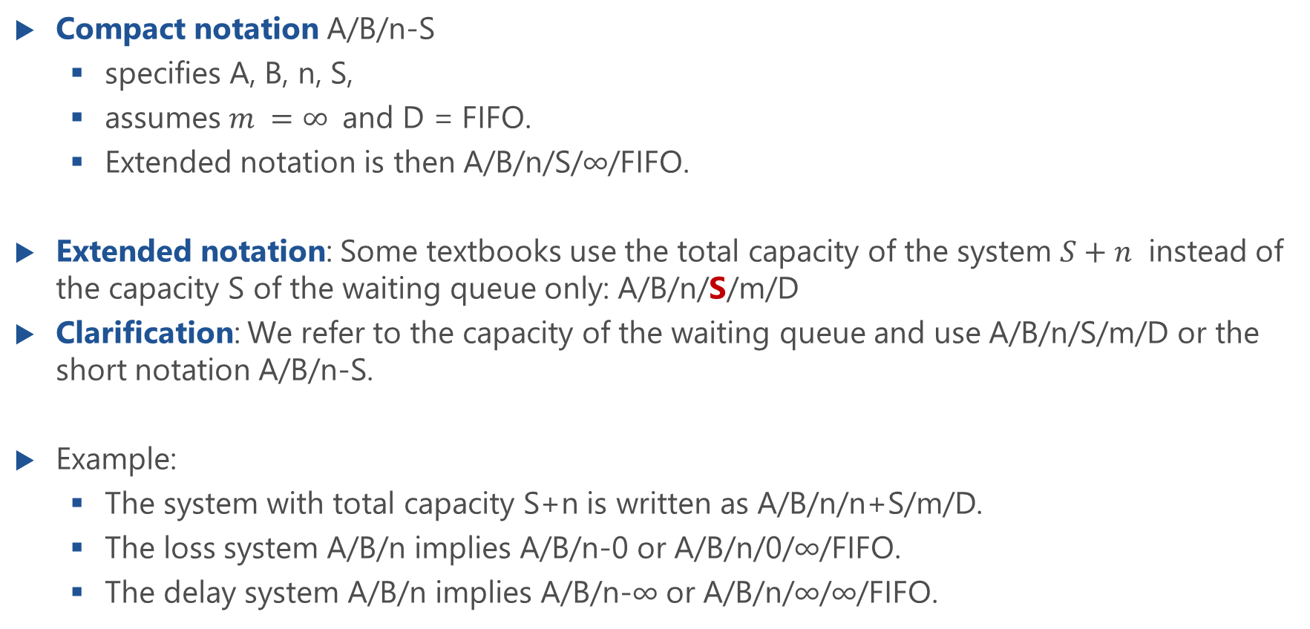
Remark: Extended Kendall‘s Notation
Compact notation A/B/n-S
specifies A, B, n, S,
assumes $m =∞$and D = FIFO.
Extended notation is then A/B/n/S/∞/FIFO.
Extended notation: Some textbooks use the total capacity of the system $S+n$ instead of the capacity S of the waiting queue only: A/B/n/S/m/D
Clarification: We refer to the capacity of the waiting queue and use A/B/n/S/m/D or the short notation A/B/n-S.
Example:
The system with total capacity S+n is written as A/B/n/n+S/m/D.
The loss system A/B/n implies A/B/n-0 or A/B/n/0/∞/FIFO.
The delay system A/B/n implies A/B/n-∞ or A/B/n/∞/∞/FIFO.

Slide 20
Notation for Arrival and Service Processes
GI – General independent
Arrival processes with renewal properties
Arrival or service process can be described with a random variable
Realizations of these random variables are statistically independent of one another
D – Deterministic
M – Markov
Corresponding random variable follows an exponential distribution
A M arrival process is a Poisson Process
E_{k} – Erlang-k distribution
H_{k} – Hyperexponential distribution (k-th order)

Slide 21
Modeling Example: Router

Slide 22
Router Model
router
packet departures
packet arrivals
arrival times
departure times
(waiting time + processing time)
very simplified model
waiting
space
service
unit
arrival process
packet departures
arrival times
departure times
waiting
time
processing
time

Slide 23
Router Model (f.)
very simplified model
waiting
space
service
unit
arrival process
packet departures
arrival times
departure times
waiting
time
processing
time
Example: M/GI/1 delay system

Slide 24
Performance Characteristics
router
Limiting resources
processing speed of router
Performance measures
queue length
throughput: #packets per time
sojourn / response time = waiting + processing time
utilization: fraction of time the router is busy (or idle)
Goal of model
impact of router speed on buffer size (queue length), throughput and utilization
Queueing model
M/GI/1-∞ delay system
packet arrivals
packet departures
arrival times
departure times
(waiting time + processing time)

Slide 25
Different Delay Systems
Periodic arrivals, identical service times, one server
Periodic arrivals, random service times, one server
#customers in system
5 Min
5 Min
5 Min
5 Min
time
Kendall‘s
notation?
#customers in system
waiting time
4 Min
7 Min
4 Min
5 Min
time

Slide 26
Modeling Example: Handshaking Protocol

Slide 27
Handshaking Protocol Illustration

Slide 28
Traffic Model of the Handshaking Protocol

Slide 29
Traffic Model of the Handshaking Protocol (f.)

Slide 30
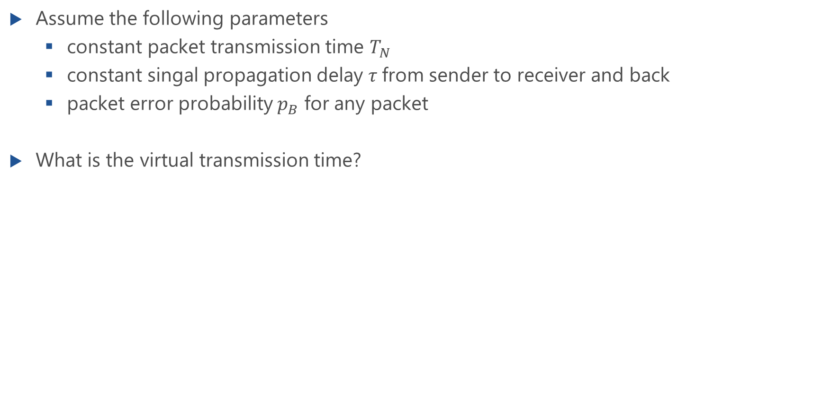
Handshaking Protocol: Virtual Transmission Time
Assume the following parameters
constant packet transmission time $T_{N}$
constant singal propagation delay $τ$from sender to receiver and back
packet error probability $p_{B}$ for any packet
What is the virtual transmission time?

Slide 31
Handshaking Protocol Summary
Limiting resources
processing of packets in the system, i.e., sending of packets over the error prone communication channel
Performance measures
response time of the system (waiting time and virtual transmission time)
throughput per packet
Goal of model
impact of packet error probability on performance measures
Queueing model
GI/GI/1-∞ delay system

Slide 32
Modeling Example: Network Dimensioning in Mobile Networks

Slide 33
Network Dimensioning in Mobile Networks
What is the arrival process? What is the service process?

Slide 34
Summary: Network Dimensioning in Mobile Networks
Limiting resources
number of communication channels in the mobile cell
Performance measures
blocking probability of customers’ calls
Goal of model
dimensioning of the number of required communication channels such that the blocking probability is below a QoS threshold for given parameters
Queueing model
M/GI/n-0 loss system

Slide 35
Modeling Example: IoT Load Balancer

Slide 36
Superposition of Arrival Processes
Kendall’s notation is extended for the superposition of two or more input streams
E.g. two arrival streams, e.g. from sensor 1 and sensor 2 with interarrival times A₁ and A₂
For 𝑘 independent arrival flows which are described by the same random variable A for the interarrival times
A₁+A₂/B/n-S
k∙A/B/n-S

Slide 37
Illustration of Superposition of Arrival Processes

Slide 38
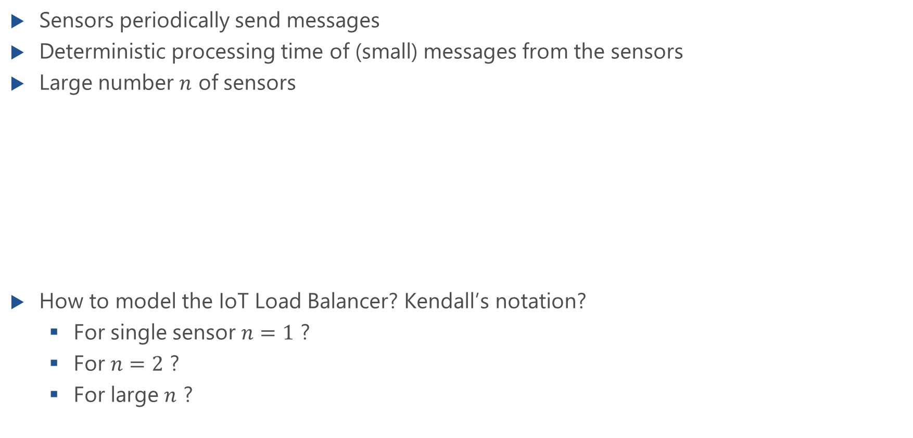
Example: IoT
Sensors periodically send messages
Deterministic processing time of (small) messages from the sensors
Large number $n$ of sensors
How to model the IoT Load Balancer? Kendall’s notation?
For single sensor $n=1$ ?
For $n=2$ ?
For large $n$ ?

Slide 39
Summary: Network Dimensioning in Mobile Networks
Limiting resources
IoT cloud load balancer
Performance measures
waiting time or response time of IoT data packets at the load balancer
Goal of model
dimensioning of the required processing power of the load balancer to keep the
mean waiting time below a predefined QoS threshold;
comparison of exact nD/D/1 model with the approximating M/D/1 queue
Queueing model
nD/1/1 and M/D/1 delay system

